Slide 1
Chapter 1 Elements of Pitch
MUS 112
January 23, 2017

Slide 2
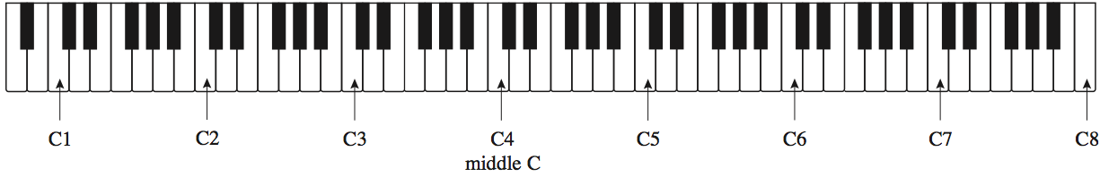
The Keyboard and Octave Registers
Pitch
Refers to the highness or lowness of a sound
Pitches are named using the first seven letters of the alphabet
A, B, C, D, E, F, & G
From any note to the next note of the same name is called an octave
All pitches from one C up to, but not including, the next C are in the same octave register and have the same number following their pitch name. The number indicates the octave register.

Slide 3
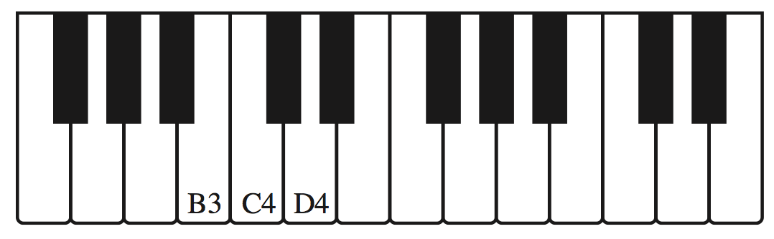
Octave Register
Notes:
Have class come to piano and quiz them.

Slide 4
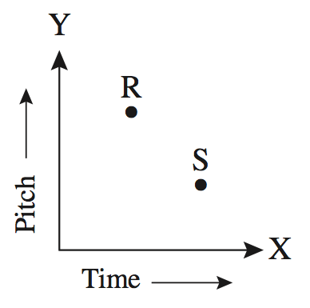
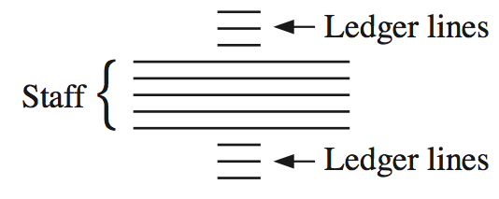
Notation on the Staff
Our system of musical notation is similar to a graph in which time is indicated on the X axis and pitch is shown on the Y axis.
A staff is used in music to indicate the precise pitch desired.
Has five lines and four spaces
Staff can be extended with
ledger lines

Slide 5
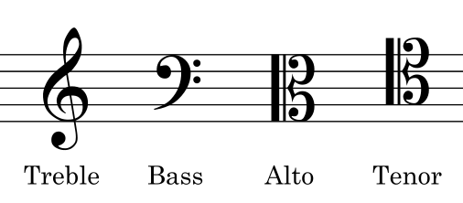
Notation on the Staff
A clef must appear on each staff so we know which lines and spaces indicate which pitch.
Three common clefs:
Each is named for the pitch that it indicates
“G” Clef “F” Clef “C” Clef

Slide 6

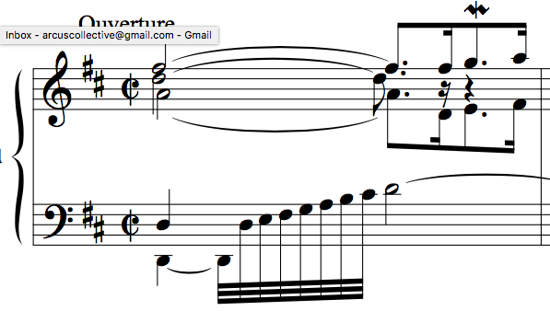
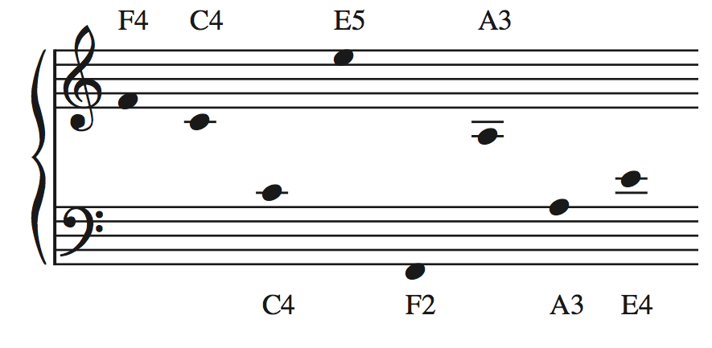
Notation on the Staff
The grand staff is a combination of two staves joined by a brace, with the top and bot- tom staves using treble and bass clefs, respectively.
Think Piano Music
SAME PITCH
SAME PITCH
J.S. Bach, Keyboard Partita no. 4 in D Major, BWV 828, Ouverture

Slide 7
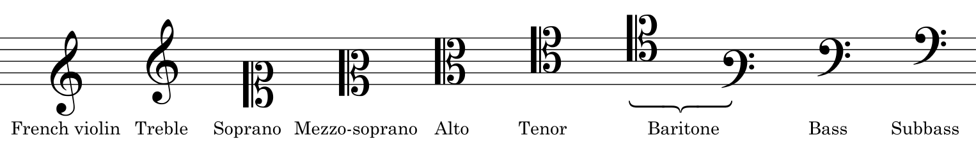
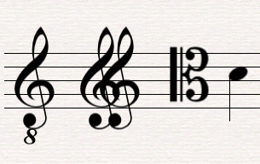
Notation on the Staff
There are a ton more clefs:
Here are some, that you don’t need to worry about:

Slide 8
Scales
Scale: a specific set of musical notes ordered by pitch
Ordered by increasing pitch = ascending scale
Ordered by decreasing pitch = descending scale
A scale can be made up of any pitches, but we will focus on major and minor scales.
These scales form the basis of tonal harmony.
What do we mean by tonal????
We mean something rather specific …………………………………>

Slide 9
Tonal Harmony refers to the harmonic style of music composed during the period from about 1650 to about 1900. his would include such composers as Purcell, Bach, Handel, Haydn, Mozart, Beethoven, Schubert, Schumann, Wagner, Brahms, Tchaikovsky, and all their contemporaries.
Much of today’s popular music is based on tonal harmony, just as Bach’s music was, which means that both types have a good deal in common
1st, both make use of a tonal center, a pitch class that provides a center of gravity.
2nd, both types of music make use almost exclusively of major and minor scales.
3rd, both use chords that are tertian in structure. Tertian means “built of thirds,” so a tertian chord might be C–E–G, a non- tertian one C–F–B.
4th, and very important, is that the chords built on the various scale degrees relate to one another and to the tonal center in fairly complex ways. Because each chord tends to have more or less standard roles, or functions, within a key, this characteristic is sometimes referred to as functional harmony.

Slide 10
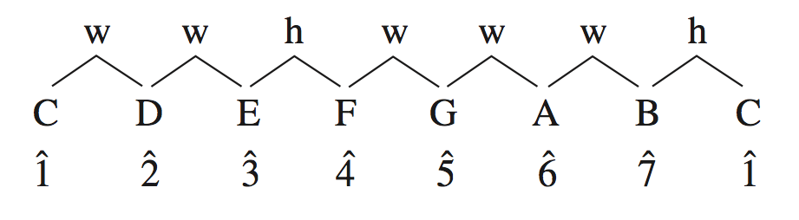
OK… Back to Scales
Major and minor scales are specfic patterns of whole steps and half steps
Half Step (h): the smallest musical interval
The distance from one key on the piano to the very next key
Whole Step (w): equal two half-steps
The next to smallest musical interval
Major Scale: w w h w w w h
We find this pattern on the white keys of the piano when starting on C

Slide 11
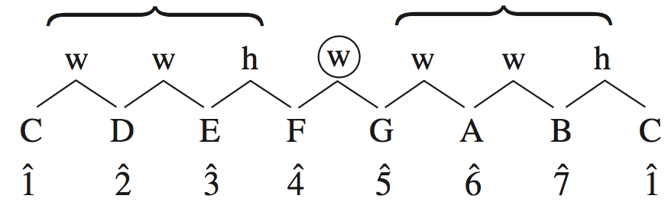
Major Scales
You can see from this diagram that half steps in the major scale occur only between scale degrees ^3 and ^4 and ^7 and ^1.
Notice also that the major scale can be thought of as two identical, four-note patterns separated by a whole step. These four-note patterns are called tetrachords.

Slide 12
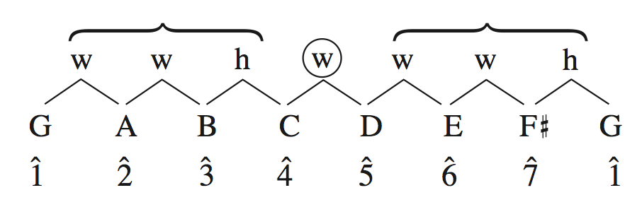
Accidentals
What happens if we start on G on ascending with only the white keys on the piano to the next G?
Do we have a major scale?
NO!!!
We need to alter (raise/lower) a pitch to make sure our interval pattern stays the same.

Slide 13
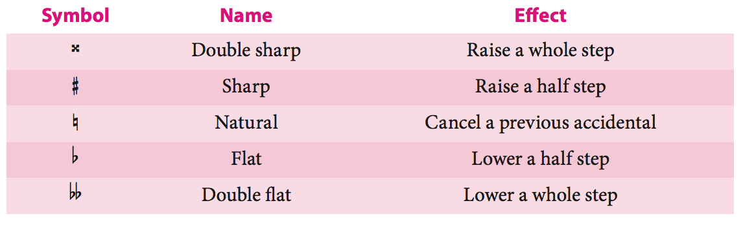
Accidentals

Slide 14
Key Signatures
Each major scale has an associated key signature that indicates the accidentals required to produce the correct pattern of notes starting on ^1.
Key signature: a pattern of sharps or flats that appears at the beginning of a staff and indicates that certain notes are to be consistently raised or lowered.

Slide 15
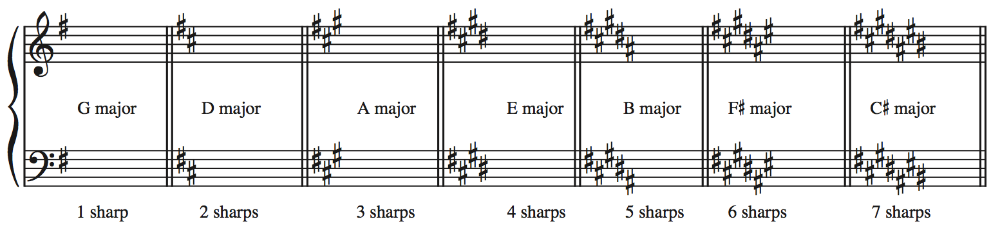
Key Signatures
There are seven major keys with sharps in the key signature:
Notice that as we add sharps we also retain the sharps
F C G D A E B
We call this the “order of sharps”

Slide 16
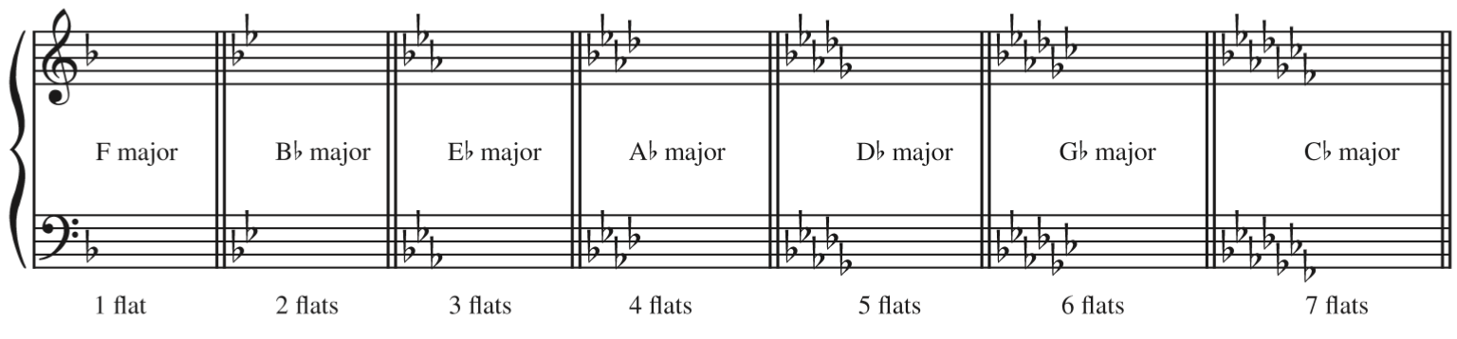
Key Signatures
There are seven major keys with flats in the key signature:
Notice that as we add flats we also retain the sharps
B E A D G C F
We call this the “order of flats”

Slide 17
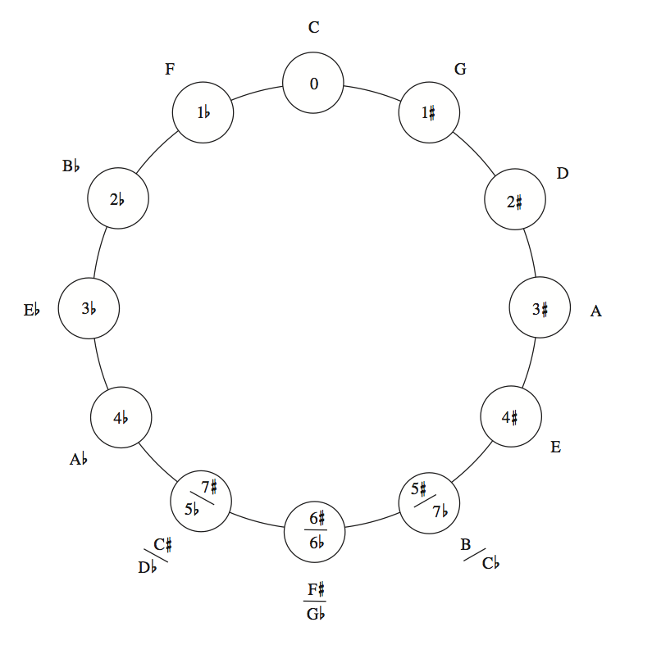
Circle of Fifths
Reading clockwise, you will see that each new key begins on ^5 of the previous key.
counterclockwise, each new key begins on ^4 of the previous one.
To get a key a fifth above, add a sharp (remove a flat)
To get a key a fifth below, add a flat (remove a sharp)

Slide 18
Key Signatures & You
You need to:
memorize all key signatures
memorize the order of flats
memorize the order of sharps
Be able to write all key signatures on all clefs
Be able to immediately recognize all key signatures
Luckily for you, the internet has anything you would ever need!
http://www.musictheory.net/exercises

Slide 19
More Scales: The Minors
The are three minor scale patterns all musicians need to know.
Natural Minor: like a major scale with lowered ^3, ^6, and ^7
w h w w h w w
Harmonic Minor: Natural minor scale with a raised ^7
w h w w h +2 h
Melodic Minor: has an ascending form and a descending form
The ascending form is like natural minor with a raised ^6 and 7ˆ or as major with lowered ^3.
w h w w w w h
The descending form is identical to the natural minor

Slide 20
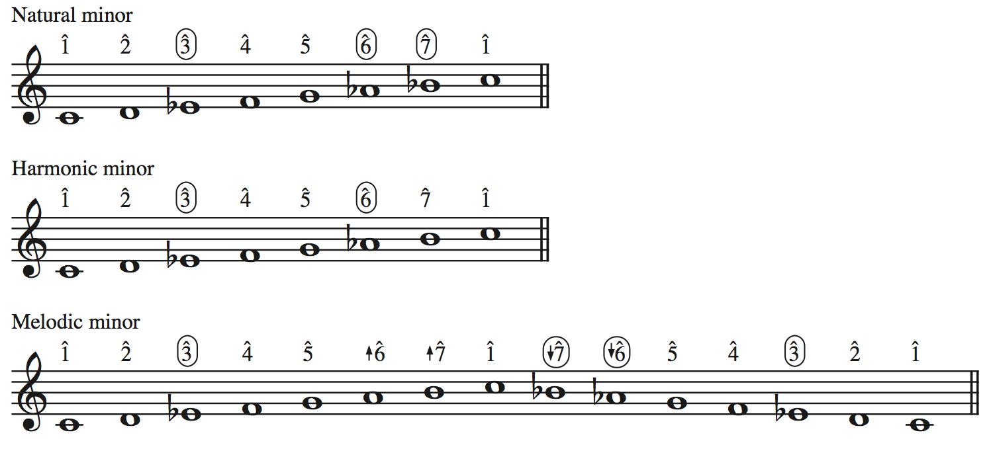
Minor Scales

Slide 21
Minor Key Signatures
Minor key signatures conform to the natural minor scale, no matter which minor scale type is actually in use.
Let’s look at f# minor
Which accidentals a required to make F# minor?
Which major key signature has these accidentals?
f# minor and A major are relative keys because they share the same key signature.
The relative major of any minor key starts on ˆ3 of the minor scale, and the relative minor of any major key begins on 6ˆ of the major scale.
Major and minor scales that share ^1 are parallel keys
Ex. F# Major and f# minor

Slide 22
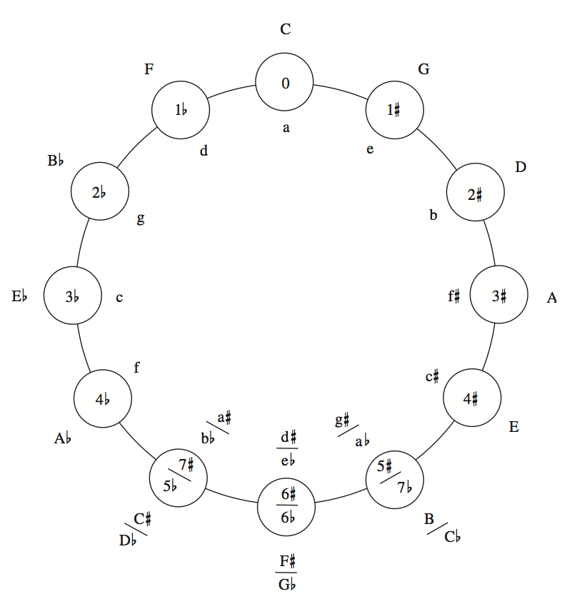
All the Key Signatures
Relative Keys
Parallel Keys

Slide 23
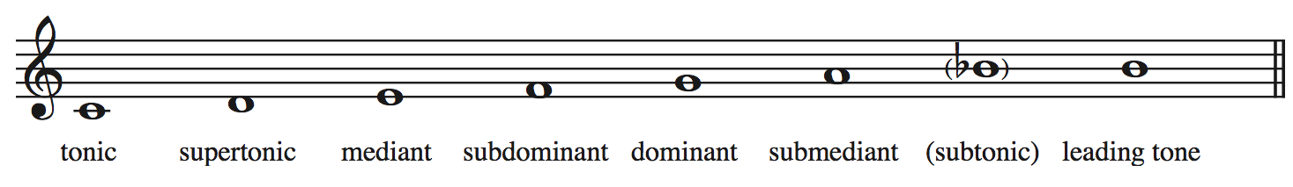
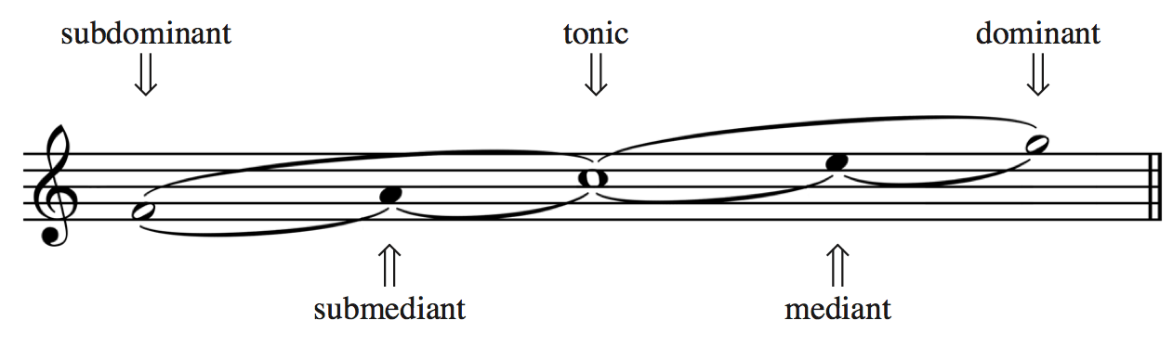
Scale Degree Names

Slide 24
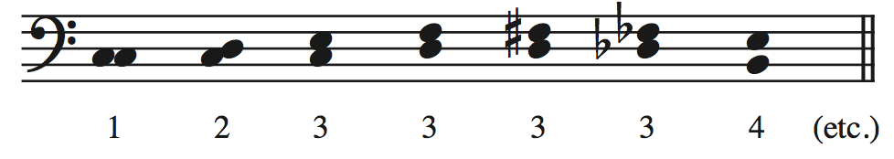
Intervals
Interval: the measurement of the distance in pitch between two notes.
harmonic interval: results when two notes sound simultaneously
melodic interval: occurs when two notes are played successively
There are two parts to every interval name: the numerical name and the modifier that precedes it
the numerical name is a measurement of how far apart the notes are vertically on the staff, regardless of what accidentals are involved

Slide 25
Intervals
Numerical intervals
Unison (instead of 1st)
2nd
3rd
4th
5th
6th
7th
Octave (instead of 8th)
9th
10th
12th
Etc…
Simple intervals
Compound intervals

Slide 26
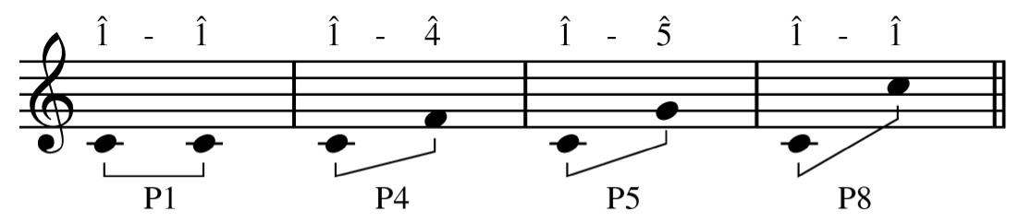
Interval Modifiers
Perfect
Refers to Unisons, 4ths, 5ths, 8ves, and their compounds (ex. 11ths)

Slide 27
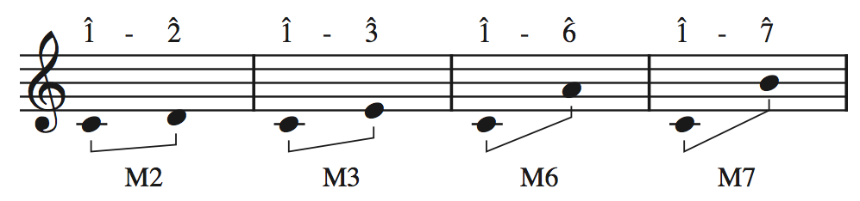
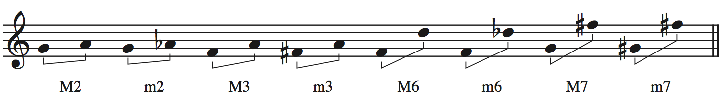
Interval Modifiers
Major/minor
Only used in conjunction with 2nds, 3rds, 6ths, and 7ths
The intervals formed by ^1–^2, ^1–^3, ^1–^6, and ^1–^7 in the major scale are all major intervals
If we lessen a major interval by a half-step it becomes a minor interval

Slide 28
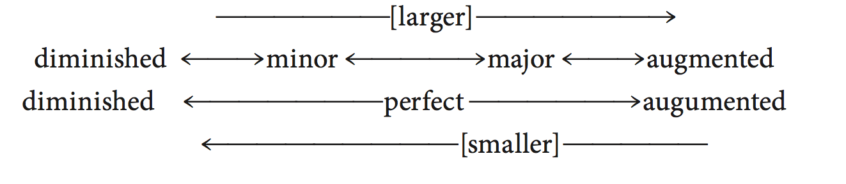
Augmented and Diminished Intervals
If a perfect or a major interval is made a half step larger without changing the numerical name, the interval becomes augmented (abbreviated +)
If a perfect or a minor interval is made a half step smaller without changing its numerical name, it becomes diminished (abbreviated º )

Slide 29
More on Intervals
There is no such thing as a diminished unison.
Why?
Doubly augmented and doubly diminished intervals are possible, but they seldom occur.
Let’s make an example of a doubly augmented 3rd
Tritone is a term used for the +4 or its enharmonic equivalent, the º5.
Enharmonic: something that sounds the same but is spelled differently
Notes: and Fb
Keys: C# Major and Db Major
Intervals: º4 and M3

Slide 30
Inversion of Intervals
We can invert simple intervals
Transpose one the notes by an octave to reverse the verticle order of the notes.
When we invert simple intervals 2 things predictably happen:
If we subtract the starting numeric name from 9 we get the ending numeric name
A 2nd becomes a 7th and vice versa
A 3rd becomes a 6th and vice versa
A 4th becomes a 5th and vice versa
The modifier also inverts (except for perfect intervals)
Major becomes minor, and vice versa
Augmented becomes diminished and vice versa

Slide 31
Consonant and Dissonant Harmonic Intervals
consonant and dissonant can be defined roughly as meaning pleasing to the ear and not pleasing to the ear, respectively
For now the following will suffice
Consonant
major and minor 3rds and 6ths and perfect 5ths and 8ves
Dissonant
All other harmonic intervals, including all augmented and diminished intervals, are dissonant. An exception is the P4, which is considered dissonant in tonal music only when it occurs above the lowest voice
This is based of off what composers of tonal music (1650-1900) traditionally wrote, our modern ears are accustomed to a much wider range of consonance.

Slide 32
Intervals & You
You need to:
Know all possible intervals
Be able to immediately recognize any intervals
Even the crazy ones
Luckily for you, the internet has anything you would ever need!
http://www.musictheory.net/exercises

Slide 33


